Slide 1
Pneumonia Detection using Deep Transfer Learning
Avinash Shekar(A20447945)
Haripriya Aravapalli(A20445663)

Slide 2
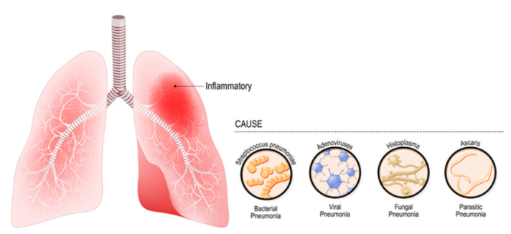
Background
Radiological images continue to grow at a significant rate compared to the number of trained radiologists/readers available.
It is estimated that in some cases, an average radiologist must interpret one image every 3–4 seconds in an 8-hour workday to meet workload demands.
AI-driven radiological image analysis has the potential to increase efficiency & reduce errors by providing trained radiologists with, in some cases, superior detection capabilities.

Slide 3


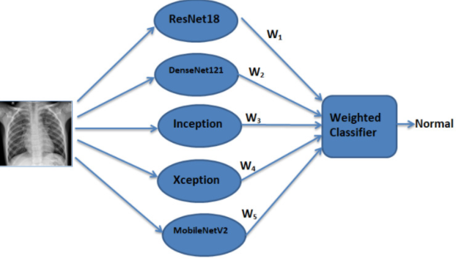
Research paper
Efficient Pneumonia Detection in Chest Xray Images Using Deep Transfer Learning.
Predictions from all transfer learning models are given optimized weights to give the final prediction.
We have used CNN, ResNet50, DenseNet121 and Inceptionv3

Slide 4
Methodology
Transform data to python readable format.
Dataset is already divided into train and test.
Use 80-20 split for train and validation.
Perform the Exploratory Data Analysis.
Preprocess the data and Implement Data Augmentation.
Try out CNN model.
Compare with ResNet18, DenseNet121, and InceptionV3 pre-trained neural networks.
Implement Weighted Classifier for all the models and obtain the classified output.

Slide 5
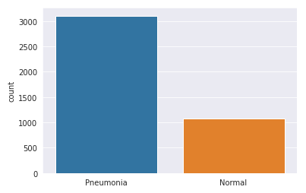
Exploratory Data Analysis
Dataset consists of 5,863 images divided into two classes Normal and Pneumonia.
The distribution of these classes is as shown
From the image we can say that data is imbalanced as pneumonia images or more than Normal images.
Implemented Data Augmentation in order to solve the problem of imbalanced data.

Slide 6
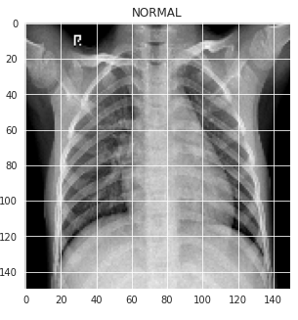
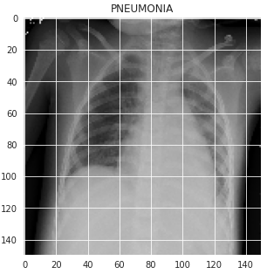
Exploratory Data Analysis

Slide 7
Data Preprocessing
All the images in the dataset should be preprocessed according to the convolutional neural network used.
For CNN model images are normalized and then resized to 150 x150.
For ResNet50, DenseNet121 images are normalized and resized to 224x224.
For InceptionV3 images are normalized and resized to 229x229.

Slide 8
Implementation
Initially the data is trained on a simple convolutional neural network with 5 layers.
We have considered transfer learning to reduce the computational costs.
ResNet50, DenseNet121 and InceptionV3 pre-trained models are used as base models to train the dataset.
The performance of the models is validated using accuracy, precision, recall, f1-score and support. In order to calculate these values confusion matrix is obtained.
The predictions from these models are combined using a weighted classifier to compute the final prediction.

Slide 9
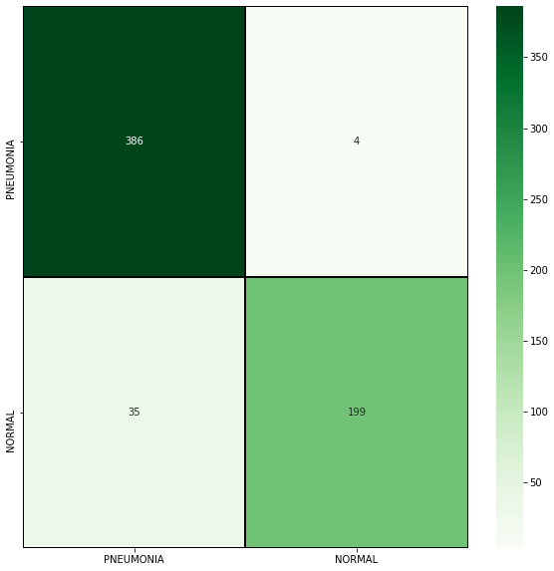
Results
Confusion Matrix for weighted classifier
Model | Accuracy
CNN | 91.02
ResNet50 | 93.58
DenseNet121 | 95.35
InceptionV3 | 87.82
Weighted Classifier | 93.75

Slide 10
Results
When transfer Learning is used the performance of the model is increased in ResNet50 and DenseNet121.
We can say that when equal weights were assigned to every model, the testing accuracy of the weighted classifier was less than that of DenseNet121.
This is because even the models with less testing accuracy were assigned the same weights as that to the models with higher testing accuracy.

